Slide 1
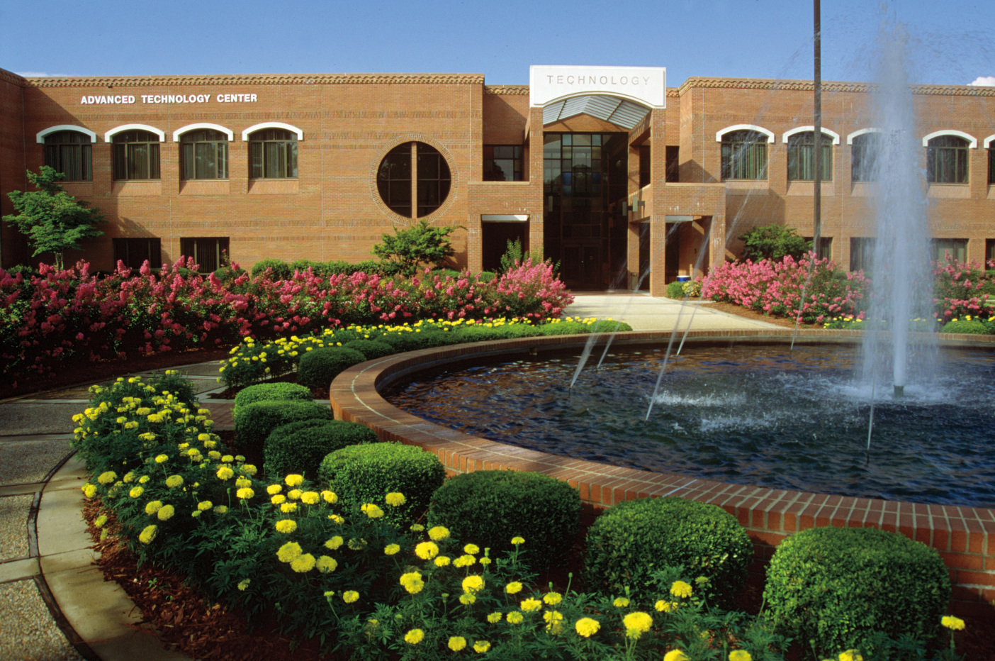

Open Computer Labs Orientation

Slide 2
Open Computer Labs
Spring/Fall Semester
Location and Hours
ATC 120 (Advanced Technology Center)
  Monday – Friday
  7:45 A.M. – 9:45 P.M.
  Saturday: 8:00 A.M. – 1:00 P.M.
  Closed on Sundays and Holidays
SLC 214 (Spring Lake Campus)
  Monday – Friday
  8:00 A.M. – 4:45 P.M.
  Closed on Saturdays, Sundays, and Holidays
***Any changes or closings will be posted in advance on Bulletin boards***

Slide 3
Open Computer Labs
Summer Semester
Location and Hours
ATC 120 (Advanced Technology Center)
Monday – Thursday:
8:00 A.M. – 9:45 P.M.
  Friday: 8:00 A.M. – 5:00 P.M.
Closed on Saturdays, Sundays, and Holidays
SLC 214 (Spring Lake Campus)
  Monday – Thursday:
  8:00 A.M. – 4:45 P.M.
  Friday: 8:00 A.M. – 1:15 P.M.
  Closed on Saturdays, Sundays, and Holidays
***Any changes or closings will be posted in advance on Bulletin boards***

Slide 4
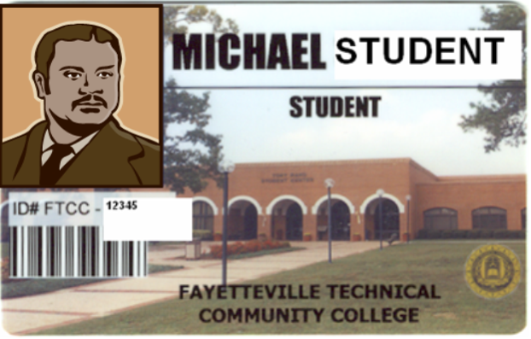
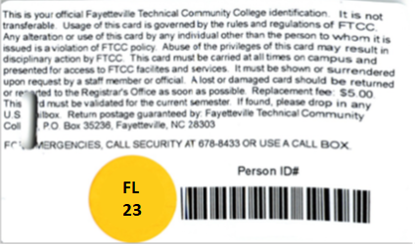
Student Identification
Users must have a valid student ID with a sticker for the current semester.

Slide 5
Single Sign On
To create the best possible user experience for students, faculty and staff, FTCC has implemented a single login that requires only one username and password, which can be used to log in to multiple college systems. FTCC has implementing Multi-Factor Authentication (MFA) for students. This will be required when you are not on one of FTCC’s campus locations occasionally. The following campus systems have been included in the single log-in system (with more systems potentially added in the future):
Academic Works
Canvas
Computer/Network/Wifi Login
Self Service
Student Email (hosted by Google Apps)

Slide 6
Username
Student logins are based on the information given during registration. i.e. first name, middle name, last name.
If your last name is seven letters or less, use all of your last name and the first letter of your first name, plus the last 4 digits of ‘Person ID’ number (on the reverse side of your Student ID Card)
Example:
  Student name: James Supersmart
  Person ID #: 0012345 (on reverse side of Student ID card)
  Username: supersmj2345

Slide 7
Username Part 2
If your last name is hyphenated or contains special characters, do not include the hyphen or special character in your username
Example:
  Student name: Angela Doe-Smith
  Person ID#: 5671234
  Username: doesmita1234

Slide 8
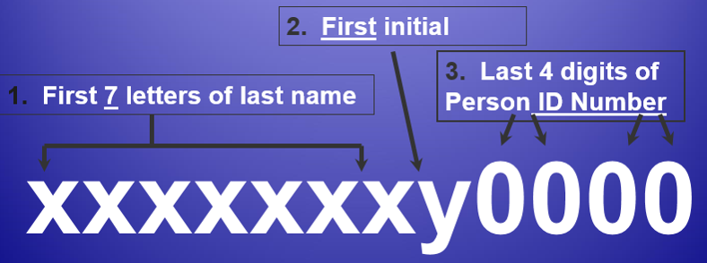
Username Example
Your username is made up of the following elements:

Slide 9
Password Format
  Returning students will use their last password or require a password reset.
  New students’ initial password is their DOB (Date of Birth) (mmddyyyy) with no dashes or spaces (example: January 2, 1980 would be 01021980).
  Password shall be at least fourteen (14) characters in length and contain letters, numbers and symbols. Valid symbols are @ $ # _ and the first character of a password must be a letter. The password must also contain a number.
  Passwords shall be random characters from the required categories of letters, numbers and symbols.
  Passwords used shall be changed at least every ninety (90) days.
  Passwords shall not be re-used until six additional passwords have been created.
  Passwords shall not contain dictionary words, abbreviations or the user’s name.

Slide 10
Password
Upon first sign-in you will be prompted to change your temporary password.
You are required to change your password during your first login attempt.
Returning students will use their last password or require a password reset.
New students’ initial password is their DOB (Date of Birth) (mmddyyyy) with no dashes or spaces (example: January 2, 1980 would be 01021980).

Slide 11
Password Reset
As of October 1, 2015, if you are new to FTCC and are unable to make it to the campus, you can use the online password reset tool to get started with the single login system.
Password Reset - The password reset link can be found in the footer of every page on the FTCC website in the “Other” column. Alternatively, you can use this address to reach the password reset page: https://www.faytechcc.edu/mis/self-service-password-reset/
When resetting your password, you will need to:
  Register in Self-Service Password Reset
  Log in with your AD address (lastf####@ad.faytechcc.edu)
  Set at least one security option
  Have your authentication method ready (email, cellphone, etc.)
All of the information is verified based on the information you provided to the College as part of the application process.

Slide 12
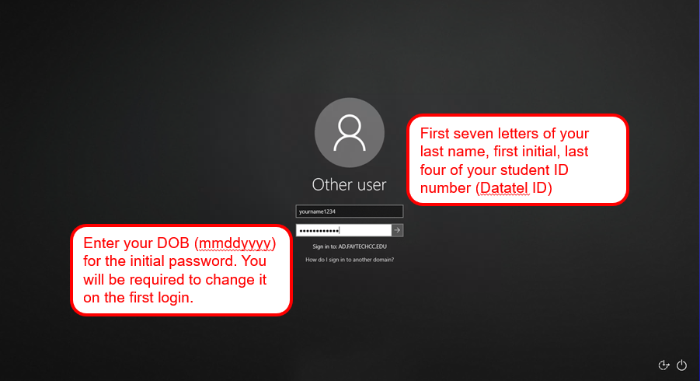
Computer Login Screen

Slide 13
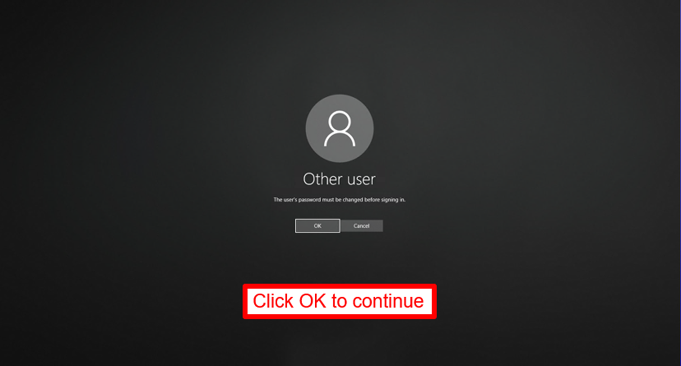
Login Password Prompt

Slide 14
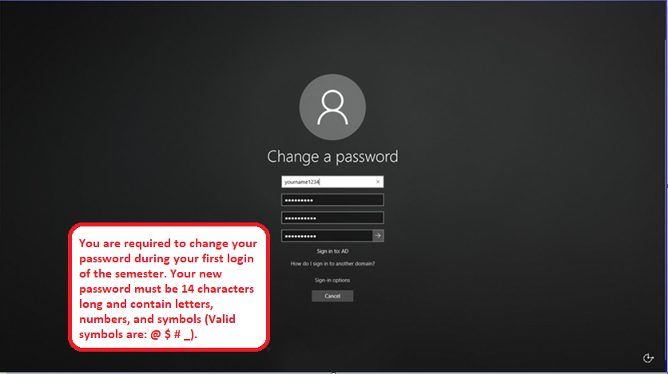
Login Password Change

Slide 15
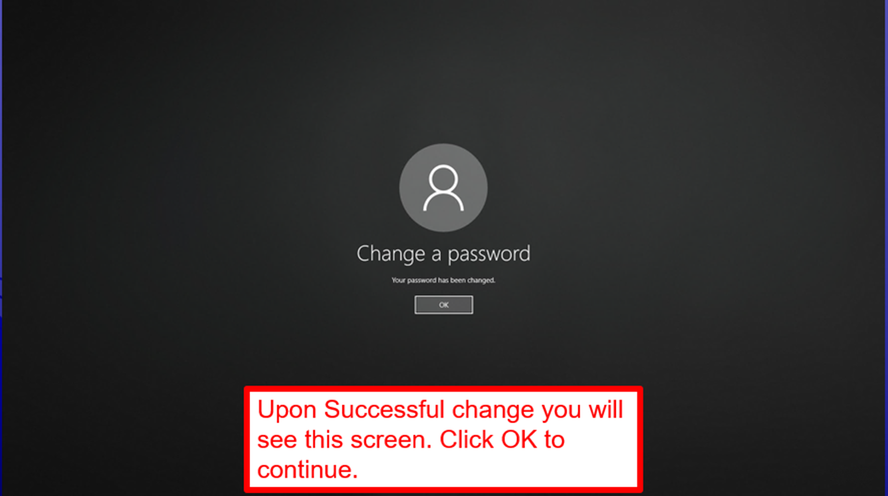
Password Change Confirm

Slide 16
Logging In
Username will be used for logging into
    Lab Computers
    Blackboard
    Student E-mail
    Self-Service
    FTCC Public WiFi
*** Please see an IT Support Specialist if you are having problems. ****

Slide 17
Open Computer Labs Admittance
Please have your Student ID with a current sticker in hand when entering the Open Computer Labs. You will be asked to show or swipe your Student ID prior to entering.
(ATC120 and SLC214)
** as per 2024 – 2025 Student Handbook Click link to view Handbook**
Notes:
Open lab

Slide 18
Open Computer Labs Procedures
Each time you enter or exit the Open Computer Labs, you will need to scan your Student ID card using one of the provided card scanners
When you swipe your Student ID card, please make sure that the barcode on the back of your Student ID card is facing to your left and that the barcode passes through the scanner.
If your Student ID card will not scan, you will need to see a IT Support Specialist for assistance.

Slide 19
Computer Labs/Classrooms Procedures
Thank you for waiting outside the computer lab/classroom until your instructor arrives.
Students must use their FTCC student login to access the computers.
Report any hardware and software problems to a IT Support Specialist. Problem Notification forms are available in all computer labs/classrooms. Please turn these in to the Open Computer Lab (ATC120).
NO FOOD OR DRINKS are allowed in the computer labs.

Slide 20
Printing
Send print jobs only once to the Printer. If the document does not print, ask a IT Support Specialist or an Instructor for assistance.
There is a limit of 10 pages per day per student for printing documents.

Slide 21

Flat Panel Monitor Care
Flat panel monitors are more vulnerable to damage. Please refrain from touching the screens with your hands or writing utensils

Slide 22
General Usage Guidelines Part 1 as per
2024 - 2025 Student Handbook
Click link to view Handbook
Computing resources and access accounts are to be used only for the purpose for which they are assigned and are not to be used for commercial purposes or non-college related activities.
Users of the network are responsible for any actions taken that cause damages or affect other computers or portable computing devices. Users should not engage in activities/actions which damage or disrupt hardware or communications such as virus creation and propagation, and overloading networks with excessive data.

Slide 23
General Usage Guidelines Part 2 as per
2024 - 2025 Student Handbook
Click link to view Handbook
Individuals will not use College computer resources to engage in any illegal activities. Users of the FTCC network must comply with all federal, state, and local laws that apply.
Users shall not create, display, advocate, or transmit threatening, racist, sexist, pornographic, obscene, offensive, annoying or harassing language and/or material, including broadcasting unsolicited messages, sending unwanted mail, or accessing websites for these purposes.

Slide 24
General Usage Guidelines Part 3 as per
2024 - 2025 Student Handbook
Click link to view Handbook
Failure to follow the FTCC General Usage Guidelines can result in the suspension of access rights and disciplinary action as deemed appropriate by the college
The Information Technology Services office reserves the right to make revisions/updates to these guidelines at any time.

Slide 25
General Usage Guidelines Part 4 as per
2024 – 2025 Student Handbook
Click link to view Handbook
Excerpt from the Student Code of Conduct:
Unauthorized use of any electronic device, such as cell phones, recorders, cameras, iPods, MP3 players, computers, and the like, in a virtual or physical classroom, shop, or lab.
Do not permit any person under the age of sixteen (16) and who is not a FTCC student to enter any instructional area without prior authorization. Instructional areas include virtual or face-to-face classrooms, labs, libraries, the Success Center, clinical sites, or shops. However, students under the age of sixteen (16) shall be permitted to enter into any instructional area for purposes related to their own education.

Slide 26
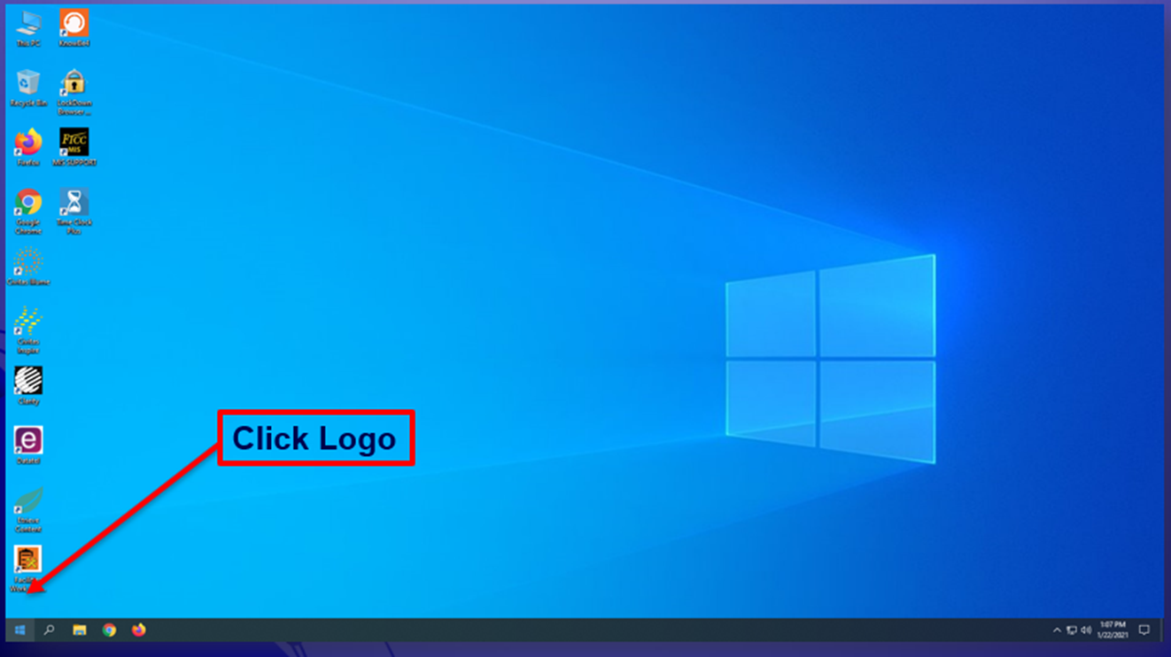
How to Log Out of the Computers Step 1

Slide 27
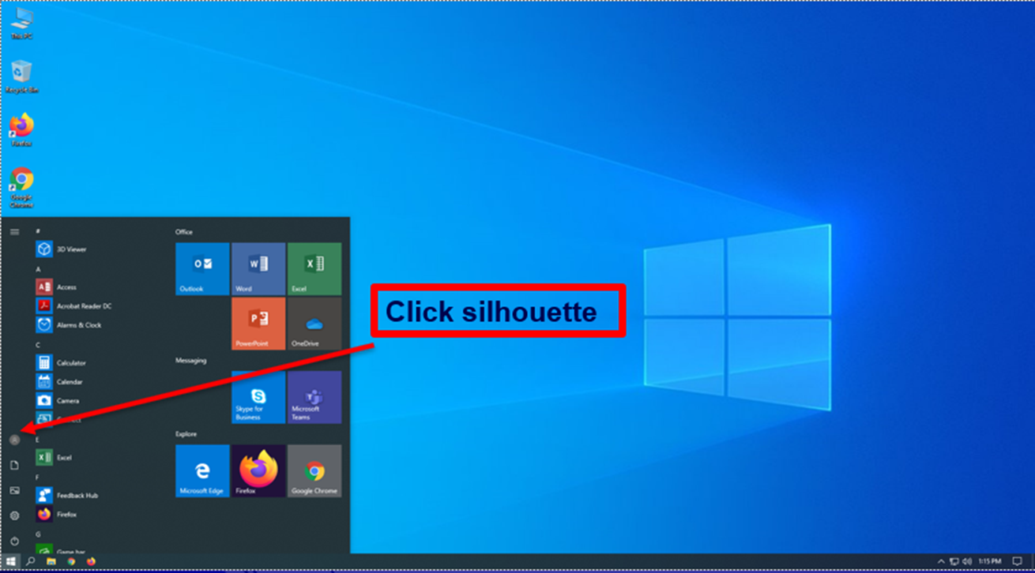
How to Log Out of the Computers Step 2

Slide 28
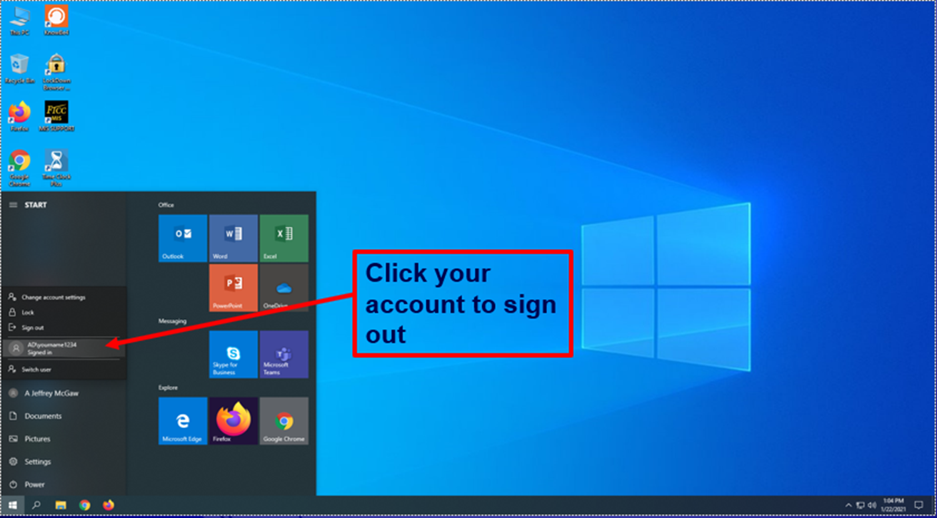
How to Log Out of the Computers Step 3

Slide 29
Contact Information
If there are any problems or concerns pertaining to the computer labs/classrooms, please use the information below for points of contact:
  ATC Main Campus – ATC 120
    Phone: (910) 678-9812
  Spring Lake and Remote Areas – SLC 214
    Phone: (910) 486-7321
  Email: help@faytechcc.edu

